Slide 1

WEB SCRAPPING AND EXPLORATORY DATA ANALYSIS
ON
IMDB CRIME MOVIES

Slide 2
ABOUT US
Name : Akula Nikhil
Qualification : B.Tech(CSE)
Experience : Fresher
I want to learn Data Science for my passionate and intrested towards it to upgrade my skills. I am believe in Innomatics and join to increse my confidence towards Data science.
Name : Paidi Suhan Reddy
Qualification: B.Tech (CIV)
Experience: Fresher
I want to learn Data Science for my passionate and intrested towards it to upgrade my skills. I am believe in Innomatics and join to increse my confidence towards Data science.

Slide 3
CONTENTS
Introduction
Problem Statement
Web scraping
Tools Used
Website
Steps For Collect Data
Raw Data
Steps For Clean Data
Cleaned Data
Data Visualization
Challenges Faced
Observation
Conclusion

Slide 4
Introduction
IMDB- is an online database of information related to films, television programs, home videos, video games, and streaming content
online – including cast, production crew and personal biographies, plot summaries, trivia, ratings, and fan and critical reviews.
Data Description
At this project we will use IMDB CRIME movies of between year 1984 to 2023 we scrap the data
from https://www.imdb.com/search/title/?title_type=feature&genres=crime&sort=num_votes,desc&start=51&ref_=adv_nxt
The datasets contains the following information:
Series_Title - Name of the movie
Released_Year - Year at which that movie released
Certificate - Certificate earned by that movie
Runtime - Total runtime of the movie
Genre - Genre of the movie
IMDB_Rating - Rating of the movie at IMDB site
Meta_score - Score earned by the movie
Gross - Money earned by that movie
Data Shape
number of rows: 1300
number of columns: 9

Slide 5
Problem Statement
The objective of this EDA was to answer a few basic questions:
How many movies are made each year?
What genres are more common?
What is the average runtime of movies?
What does the IMDB rating distribution look like for all movies?
How much box office revenue for most of the movies ?
What are the movies with top meta score?

Slide 6
Webscraping
The Internet has the massive volume of data that can use the collect the data and analysis on the data.
The collected data may unstructured or semistructured data.
We use Beautiful soup and Selenium are used in our project to scrap the data from website
STEPS:
Find the URL to scrape the data
Request the server for the response
Inspect the page
Identify the data to extract
Store the data in required format

Slide 7


TOOLS USED
Web scraping
Python
Request
BeautifulSoup
Selenium
Data Cleaning and Manipulation
Numpy
Pandas
Regular Expression
Data Visualization
Matplotlib
Seaborn

Slide 8
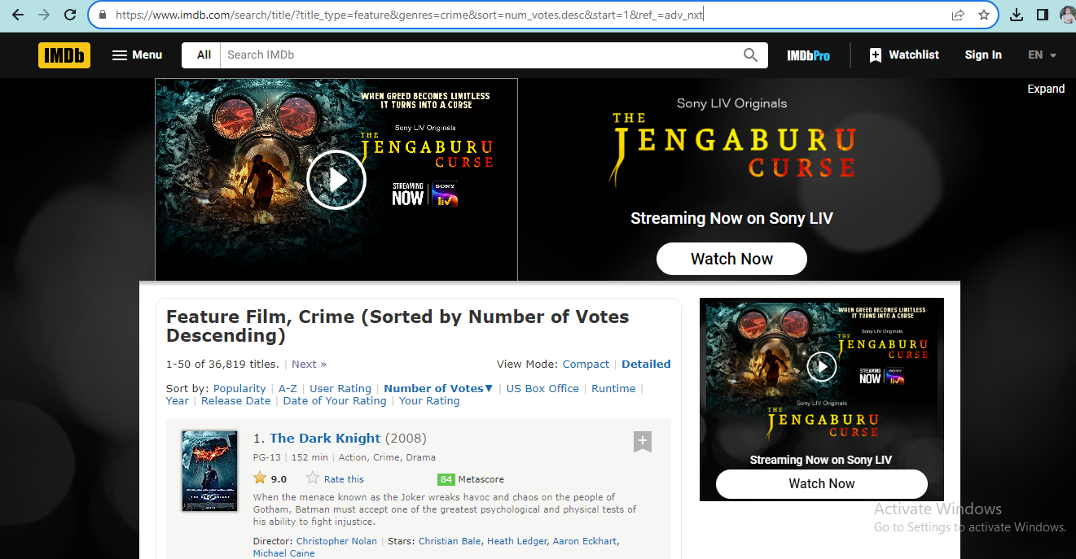
Website
https://www.imdb.com/search/title/?title_type=feature&genres=crime&sort=num_votes,desc&start=1&ref_=adv_nxt

Slide 9
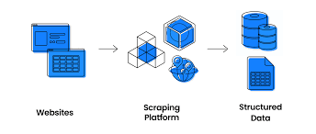
Steps for collect Data
Select the website to scrape the data
Import the necessory libraries(if not found install the library)
After scraping check for the every column length
If length is same of all the columns make it as a DataFrame
Finally Save it in a required format (we save it in csv format)

Slide 10
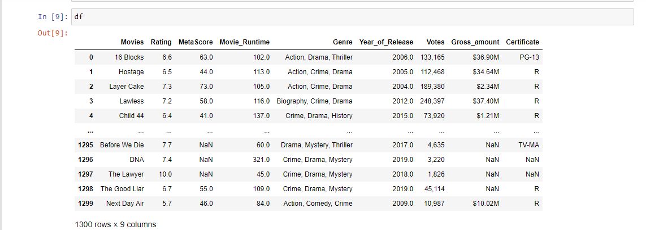
Raw Data

Slide 11
Steps For Cleaning Data and Manipulating Data
Check for Duplicates
Drop the Duplicates
Checking and removing special charecters
Data type conversion
Checking for missing values and perform based on criteria

Slide 12
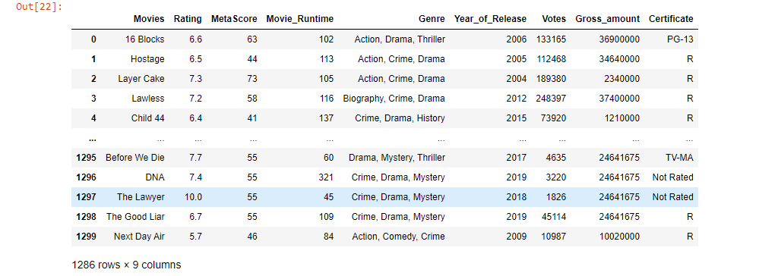
Cleaned Data
After Data cleaning, remaining data with 1286 rows and 9 columns

Slide 13
Data Visualization
Data visualization make the data more understand
Visualization such as bar graph pie chart, count plot , heat map are used to visualize the data to easy understand
This can help you easily understand the average movie run time, no.of movies in a particular year and Gross amount collected by a movie

Slide 14
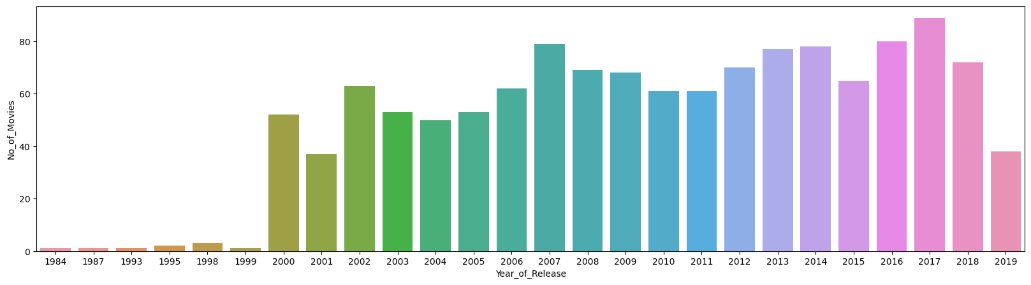
Univariate Analysis
#Insights
From this we can easily identify the how many movies relesed in a year
From barchart we found that 2017 year has most released crime movies and least movies is 1984

Slide 15
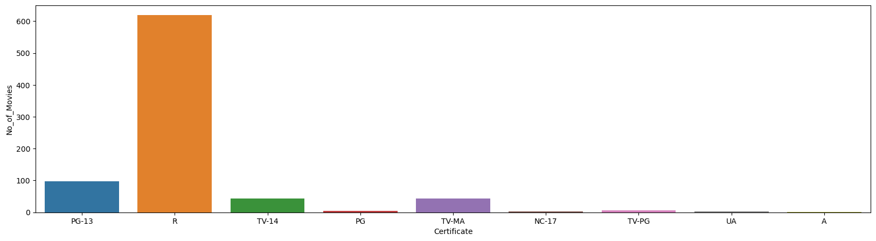
# Insights
Most of the crime rated movies has certified with R and least of the movies are released with A certified

Slide 16
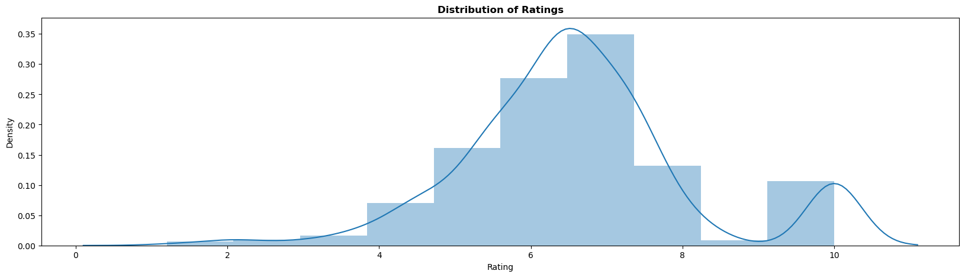
#Insights
Most of the movie has rating 7 to 8 and very few of movies with rating 0 to2

Slide 17
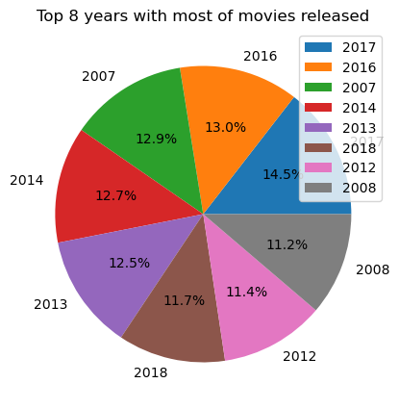
From bellow chart we analyse that most of the movies are released in following years.

Slide 18
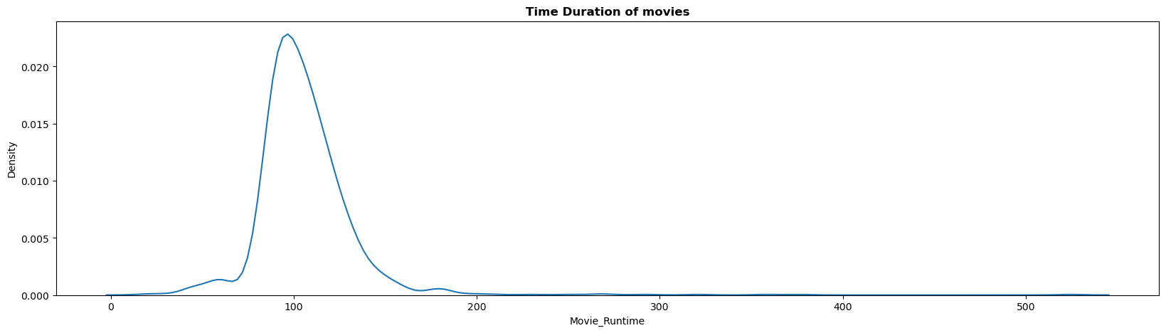
Most of the movies runtime 100 minutes and least 40 minutes

Slide 19
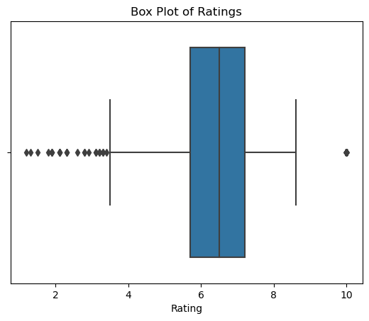
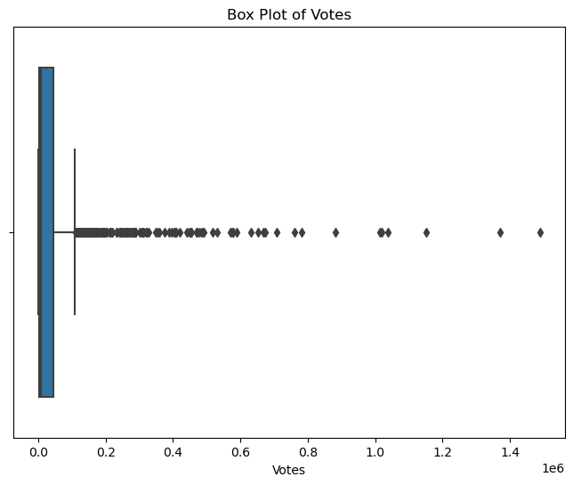
Most of the movies are rated with 3.5 to 8.5
Before and after the whiskers are outliers
Most of the votes for movies between 0 to 0.1 million

Slide 20
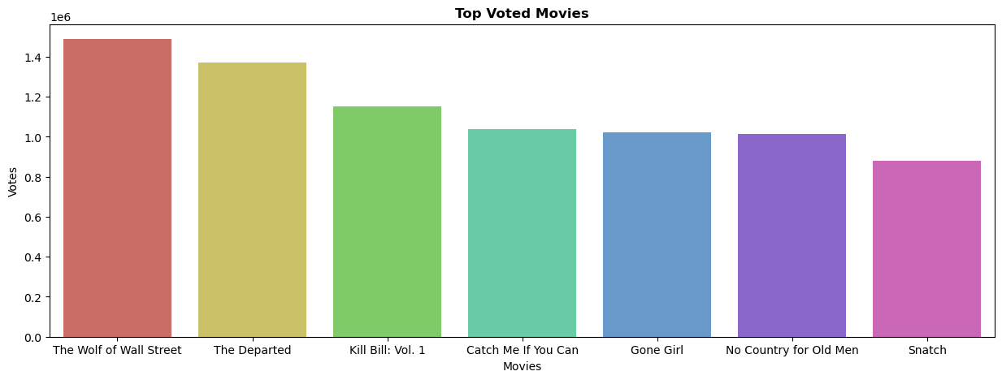
Bivariate Analysis
From bellow these are the top voted 7 voted movie.

Slide 21
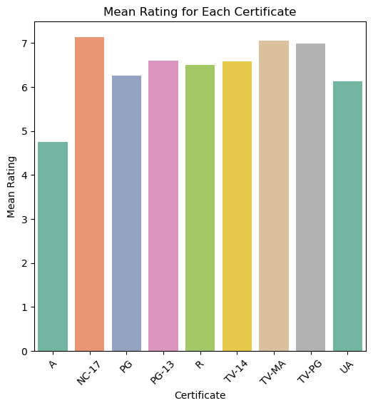
MC-17 and TV-Ma are with top mean rated movies and least maen rated are A certified

Slide 22
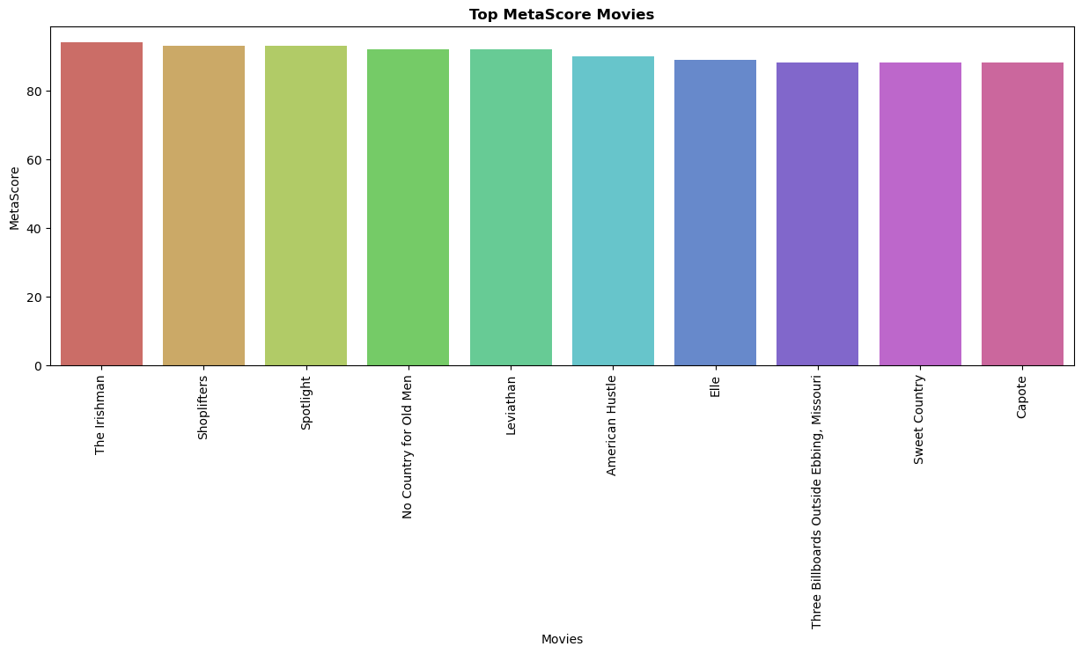
These are the movies with top 10 metascore films.The Irishman has top metascore

Slide 23
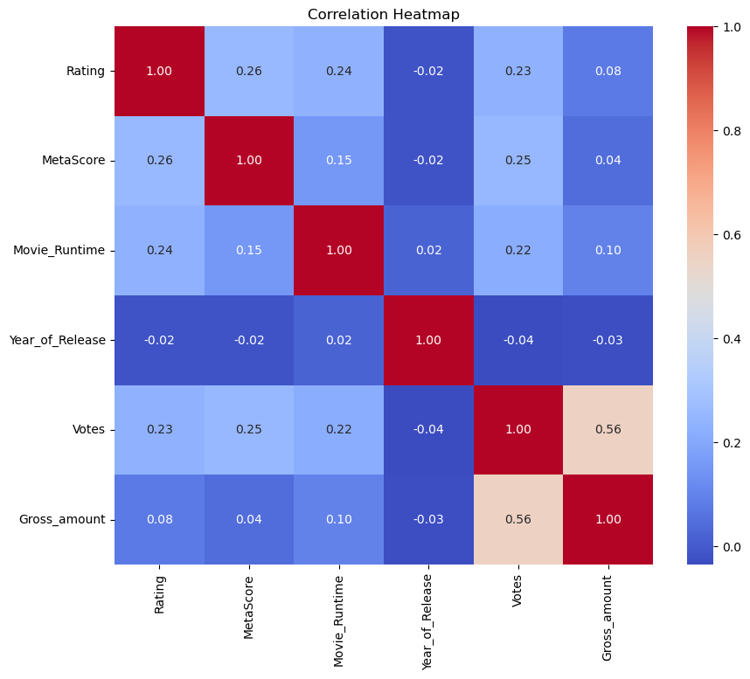
Multivariate Analysis
Votes and gross amount has highest correlaton hence Analysis on this columns give a better result

Slide 24
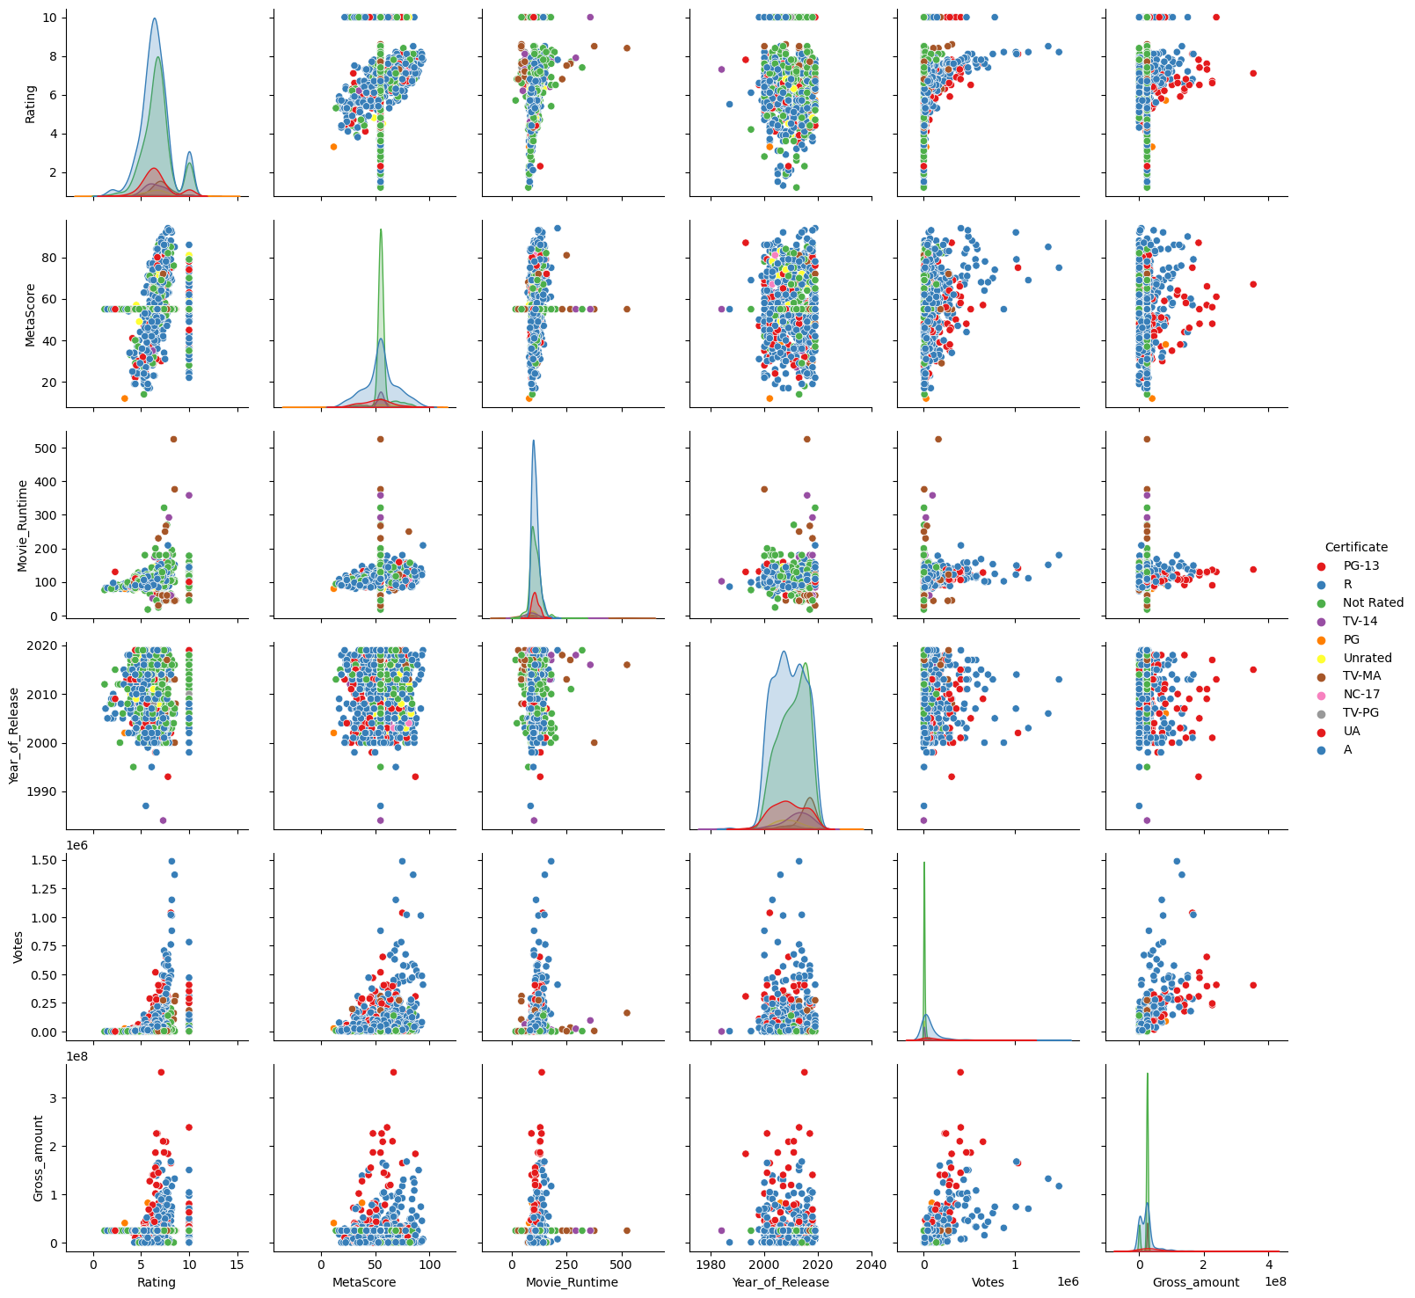
From bellow chart we analyse the relationship among the numerical Data with certificate

Slide 25
Challenges Faced
Had same tags and values
Losing data.
Duplicated values
Overcome
Using selenium to page change and not print duplicates
Collected Data unordered way which is not readable we converted into readable format

Slide 26
Observations
From EDA we know the
Most movies are released year
Top rated movies
Most of the movies with certificate
Top metascore movies
Range of movies runtime

Slide 27
Conclusion
The distribution of movie ratings are slightly right skewed
The valuable insights for success of a movie is movie rating,genre,certificate.
Movies with higher votes tends to most rating and gross amount high
There are few outliers in gross amount and votes S

Slide 28

THANK YOU

